Slide 1
Honeywell Aerospace
Kruti Tanna
October 30, 2018
How we prepare for a RCRA inspection and how we respond

Slide 2
What is a RCRA Inspection?
Usually conducted by ADEQ
Most of the times, these inspections are unannounced
Some companies receive a courtesy email regarding the inspection
- VESP involvement

Slide 3
Before An Inspection Happens
Be prepared.
- Review the field checklist
- Go-see/ Gemba inspection with the team
Have a designated person on site to deal with an inspection
This person must be competent and aware of the process and paperwork that will be requested
Make sure the environmental records are up-to-date and in order.
Few examples: Permits, manifests, waste storage logs, SDS, lab analysis, RCRA training, etc.
Have the records in a central location

Slide 4
Mock Inspections
Conducted once a year
Reminder on site’s compliance calendar
Inspection performed with the HSE team to ensure no gaps
ADEQ’s inspection checklist is used to perform the mock inspection

Slide 5
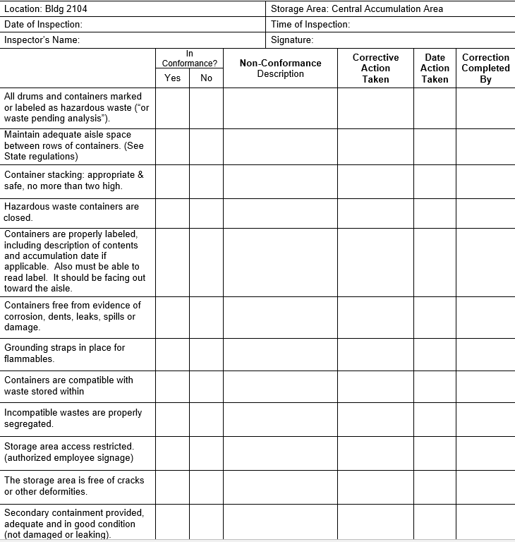
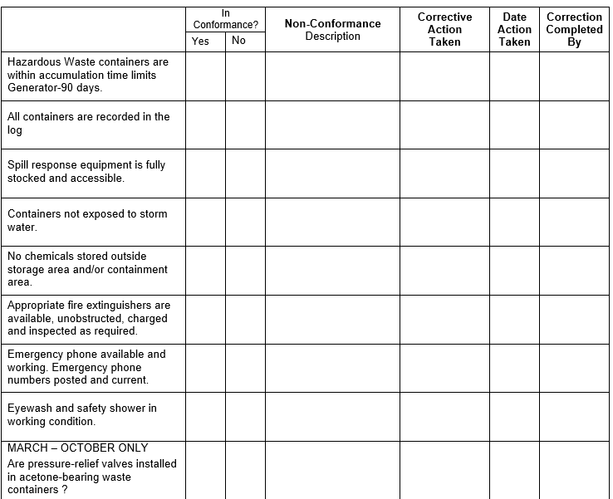
Tasks related to RCRA
Daily visual SAA inspections – By the area reps on the shop floor
Weekly inspections of the
90-day storage area

Slide 6
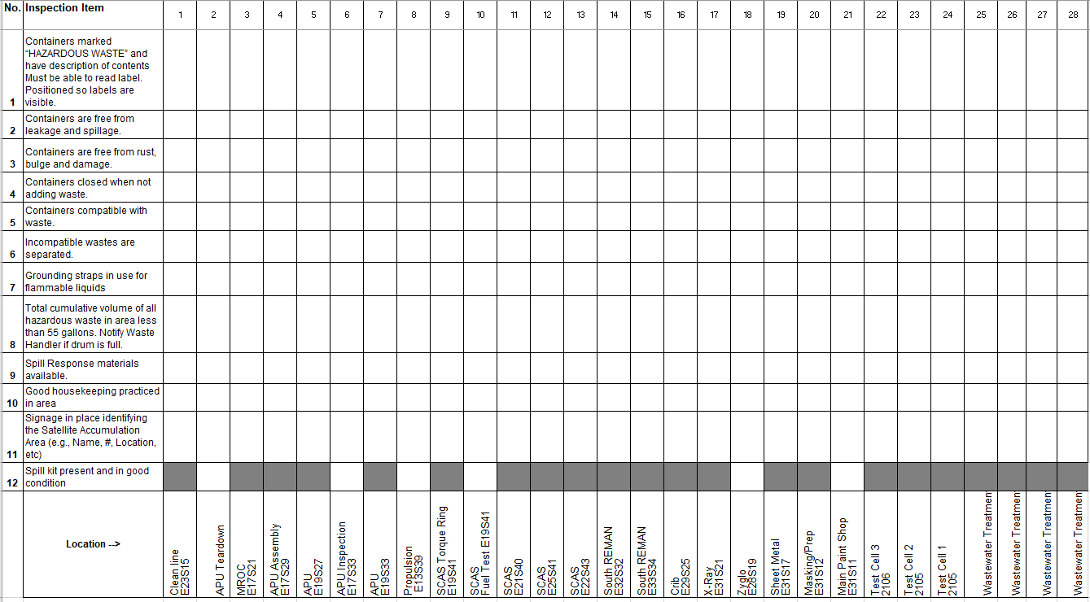
Tasks Related to RCRA
Weekly SAA inspections

Slide 7
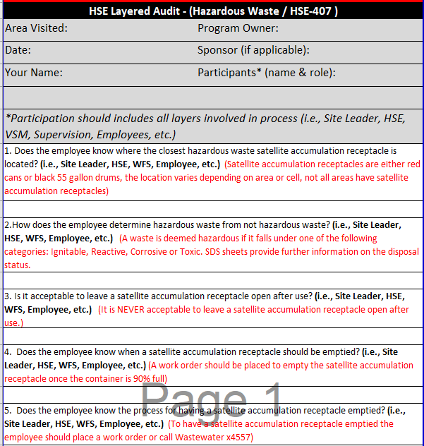
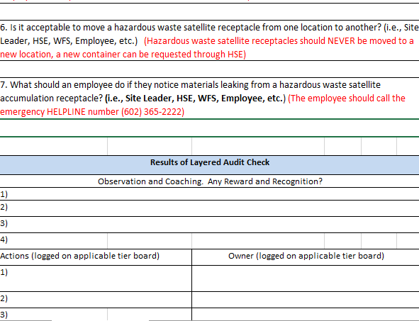
Tasks Related to RCRA
HSE Layered Audit – Performed by the HSE team
Coaching
Training
Trending
Organizing kaizen events

Slide 8
What to do when an inspector arrives
Understand the purpose, verify their credentials and escalate the arrival to the HSE&F leadership
Ask and understand why the facility is being inspected

Slide 9
Opening Conference
Can be a formal meeting or a brief informal discussion of the inspection
Important for the site leader to be aware of opening conference
Inform the inspector about the safety and PPE requirements for the site
Ask:
Purpose of the visit and scope of the inspection
If the inspection due to a complaint, referral or program inspection
What they want to see before going through the site – this will help in creating a plan by using the most direct routes

Slide 10
The Actual Inspection
Walk the site with the inspector
Address employee interviews
Review the field checklist with the inspector
Review as many records with the inspector while they are still on site

Slide 11
Closing Conference
Ensure a closing conference is conducted
Site leader’s presence is necessary
Demonstrate that you have attempted to correct all issues promptly
For example, if the inspector identified a drum unlabeled, make sure it is labeled ASAP and point it out at the closing conference.
Receive a summary of the findings and some reference to potential violations.

Slide 12
Thank you!

